Slide 1


PROGRAM PLANNING
HOW-TO GUIDE

Slide 2
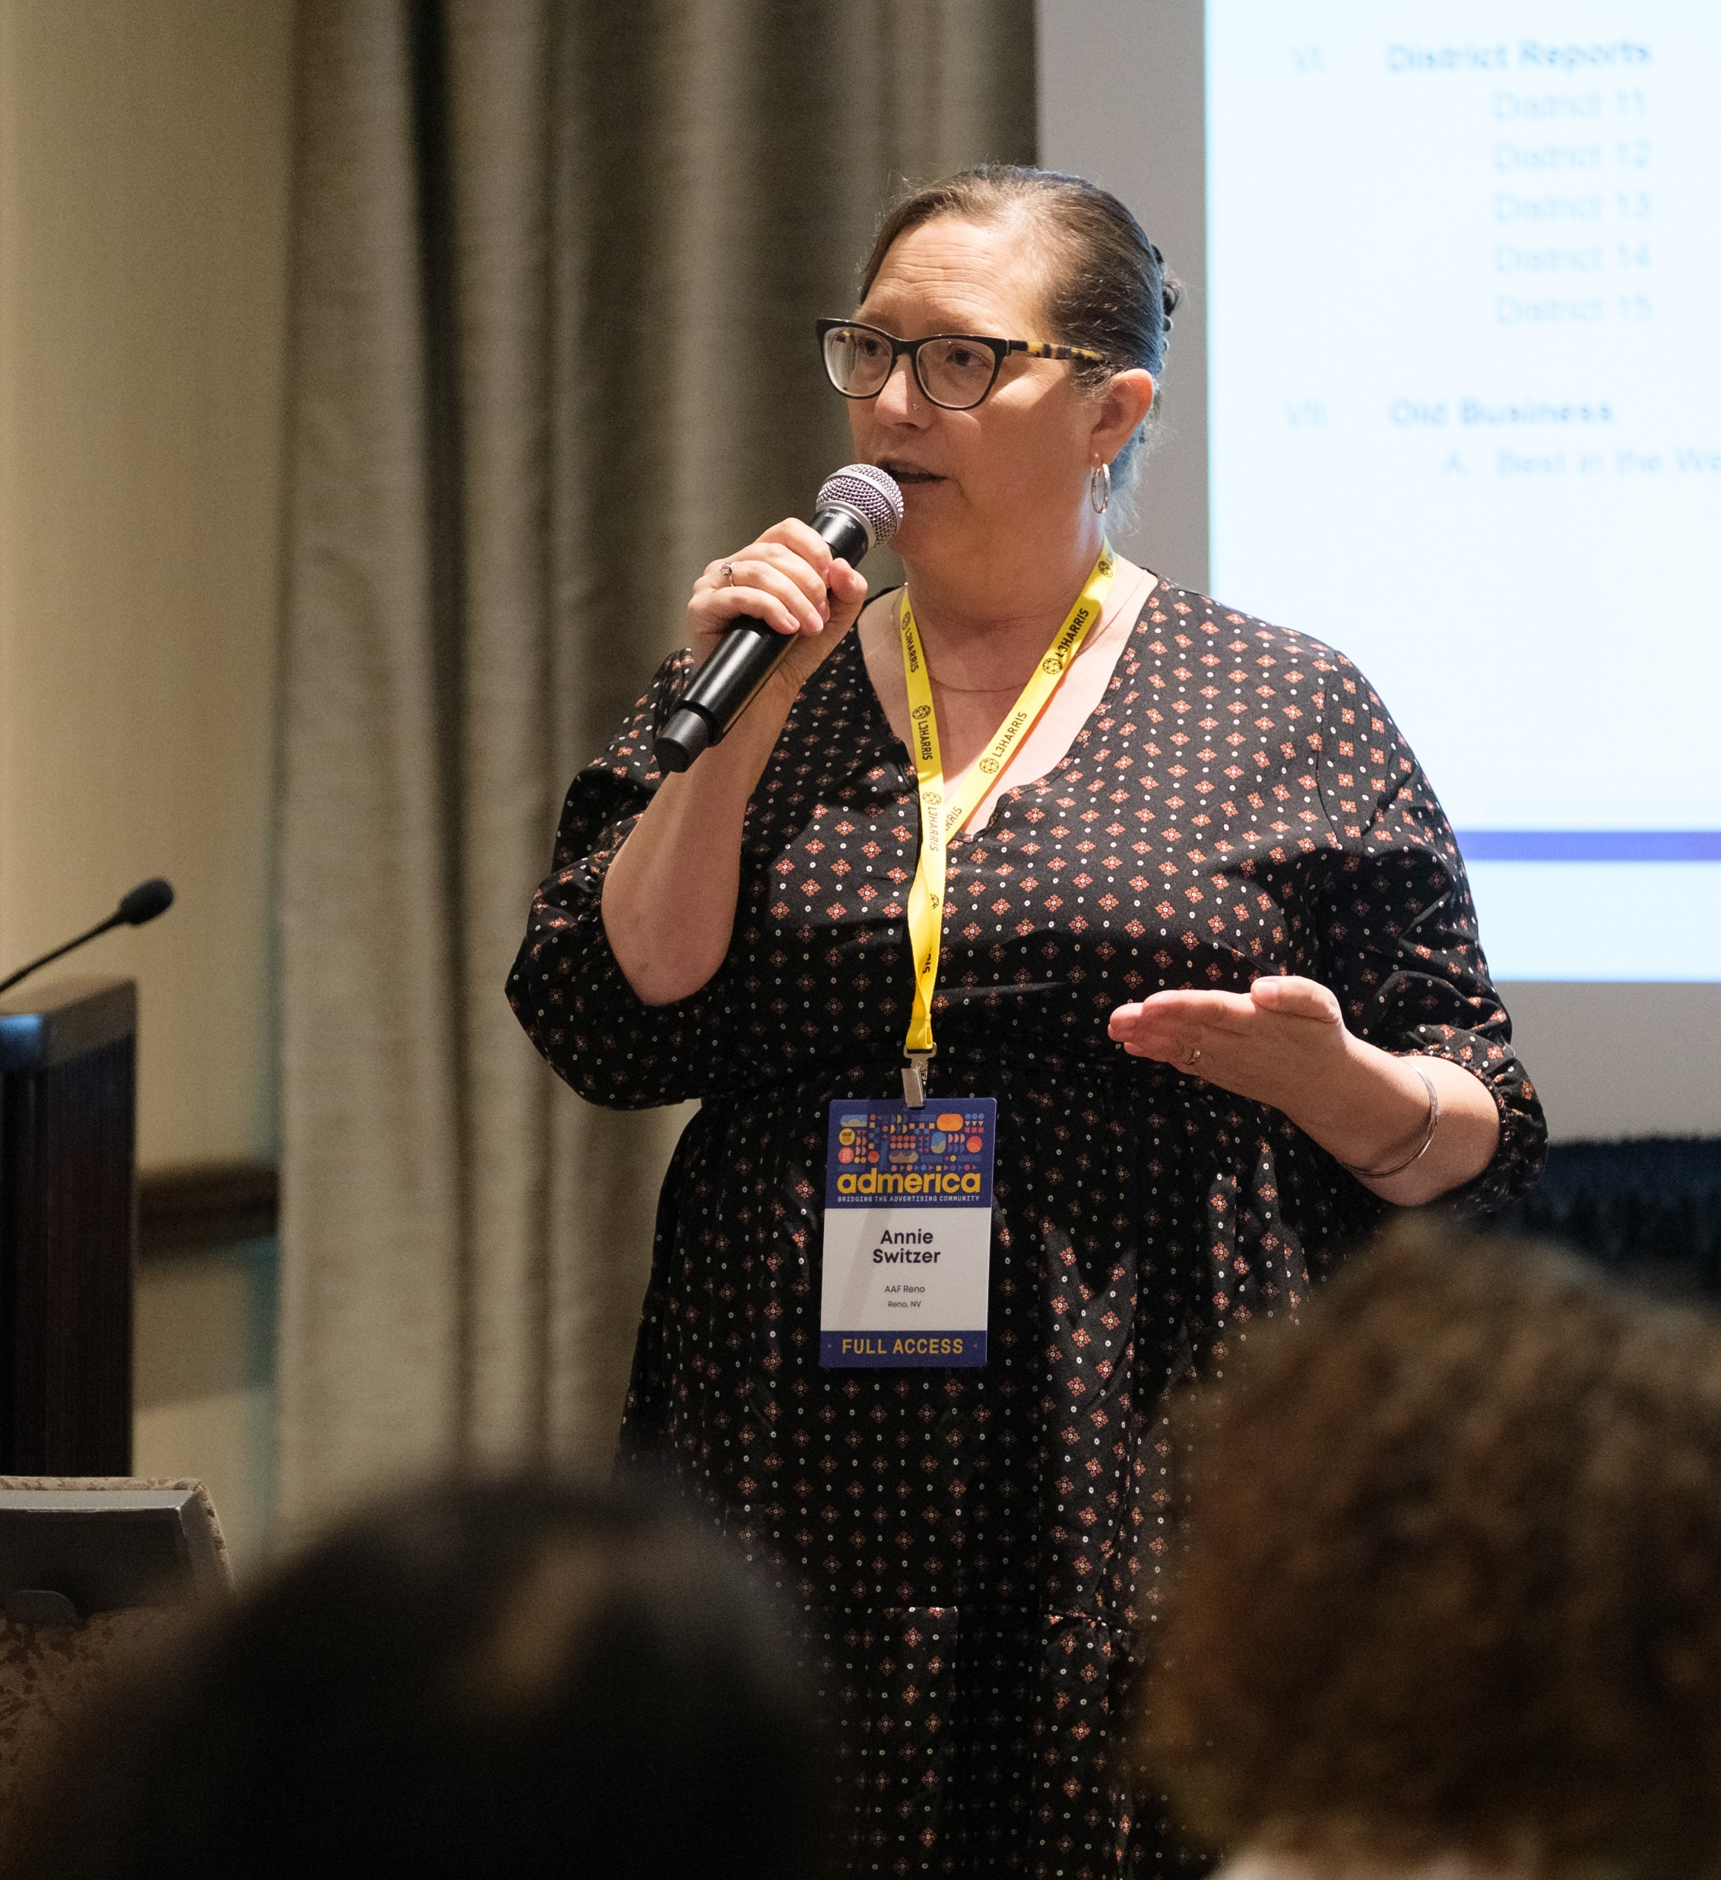
PROGRAM PLANNING
Beyond question, the program chair is eminent among those contributing to the success of any chapter. The program chair directs one of the most important chapter activities. Without good programming no chapter can be successful or even survive for very long. This guide is designed to help carry out this all-important assignment.
The job is not easy. It takes imagination, planning, determination and follow-through. It’s hard work, but can also be the most rewarding job in your chapter. Good luck in meeting the challenge.

Slide 3
PLANNING FOR PROGRAMMING

Slide 4

THE KEYS
TO SUCCESS
Member Retention: Surveys show high-quality programs are a primary reason members stay with the chapter.
Growth Strategy: Strong programming is the most effective tool for increasing recruitment.
Dedicated Leadership: Most chapters utilize a Program Committee focused exclusively on meeting content.
Positive Impact: Exceptional programs drive active interest, higher attendance, and expanded activity opportunities.

Slide 5
THE PROGRAM COMMITTEE
When building your program committee, it is important to:
Strategic Selection: Chapter success relies on the leadership, talent, and ingenuity of committee members.
Diverse Representation: Recruit from various sectors like traditional agencies, in-house marketing, digital, production, and design.
Balanced Perspectives: A broad cross-section of members ensures well-rounded and inclusive programming.
Subcommittee Structure: Form small groups of four to five members to manage specific meetings throughout the year.
Reduced Workload: Delegating to subcommittees lightens the burden and increases member involvement.
Varied Content: Focus on timely and interesting programs while interspersing social activities for networking.
Long-Term Vision: Plan months in advance to bridge administrations and ensure the chapter remains a community pillar.
Learn more about the various Chapter Leadership Resources
from the AAF

Slide 6
BUDGETING FOR PROGRAMMING
A chapter with no budget for programming is at a distinct disadvantage, particularly in getting exceptional speakers. Some speakers who might be ideal for your chapter may charge a fee. Many other fine speakers available to you charge no fee but require that their expenses be paid. And sometimes other programs that do not involve bringing speakers may still involve some expenses such as audiovisual equipment.
Your chapter should have a budget for programming. The amount, of course, will depend on your chapter’s income, expenses and priorities. However, if you have little or no budget for programming, perhaps you should consider conducting a special fund- raising event specifically to finance programming expenses.

Slide 7
SURVEYING THE MEMBERSHIP
The program committee’s most difficult job is providing programs that will have the greatest appeal to chapter members. Some chapters poll the membership by email surveys. Others use personal contacts, committee reviews or handouts at meetings. Whether formal or informal, such surveys will serve as a guide for the programs committee. Regardless of surveys, however, the committee must constantly be thinking of new ideas and striving to make every program interesting, stimulating and timely.

Slide 8
EFFECTIVE PLANNING & EXECUTION
Develop a tentative outline of programs and meeting dates for the entire year once the budget and member preferences are set.
Assign specific topics to subcommittees or individual members to ensure clear ownership.
Hold regularly scheduled committee meetings and distribute updated outlines to all members.
Issue periodic reports to show confirmed speakers and status updates.
Require a written agenda for each program to be shared with the chapter president and committee chair.
Coordinate promotion, guest speaker hospitality, and post-event thank-you letters.
Use a planning guide to ensure no major organizational elements are overlooked.
Maintain an "idea file" of speakers and topics to assist future committees and ensure chapter continuity.

Slide 9
MAINTAINING FLEXIBILITY
Sometimes, unexpected opportunities come up for exceptional programs. An unusually good speaker may just happen to be in town and available to speak to your chapter, or perhaps a community happening provides a chance for a very special program. It is important to keep your program schedule flexible enough to take advantage of such opportunities. This may involve rescheduling speakers or programs or holding your meeting on a different day than usual. Whatever is required may well be worth the effort for an outstanding program.
Despite the need for flexibility, do not fail to plan for and schedule programming for every meeting. (You can’t afford to count on windfalls.) In fact, you should also plan in advance (and hold in reserve) programs to use in case of emergency, such as a last-minute cancellation by a speaker. (This subject will be discussed in more detail later.)

Slide 10
GETTING
THE SPEAKER

Slide 11
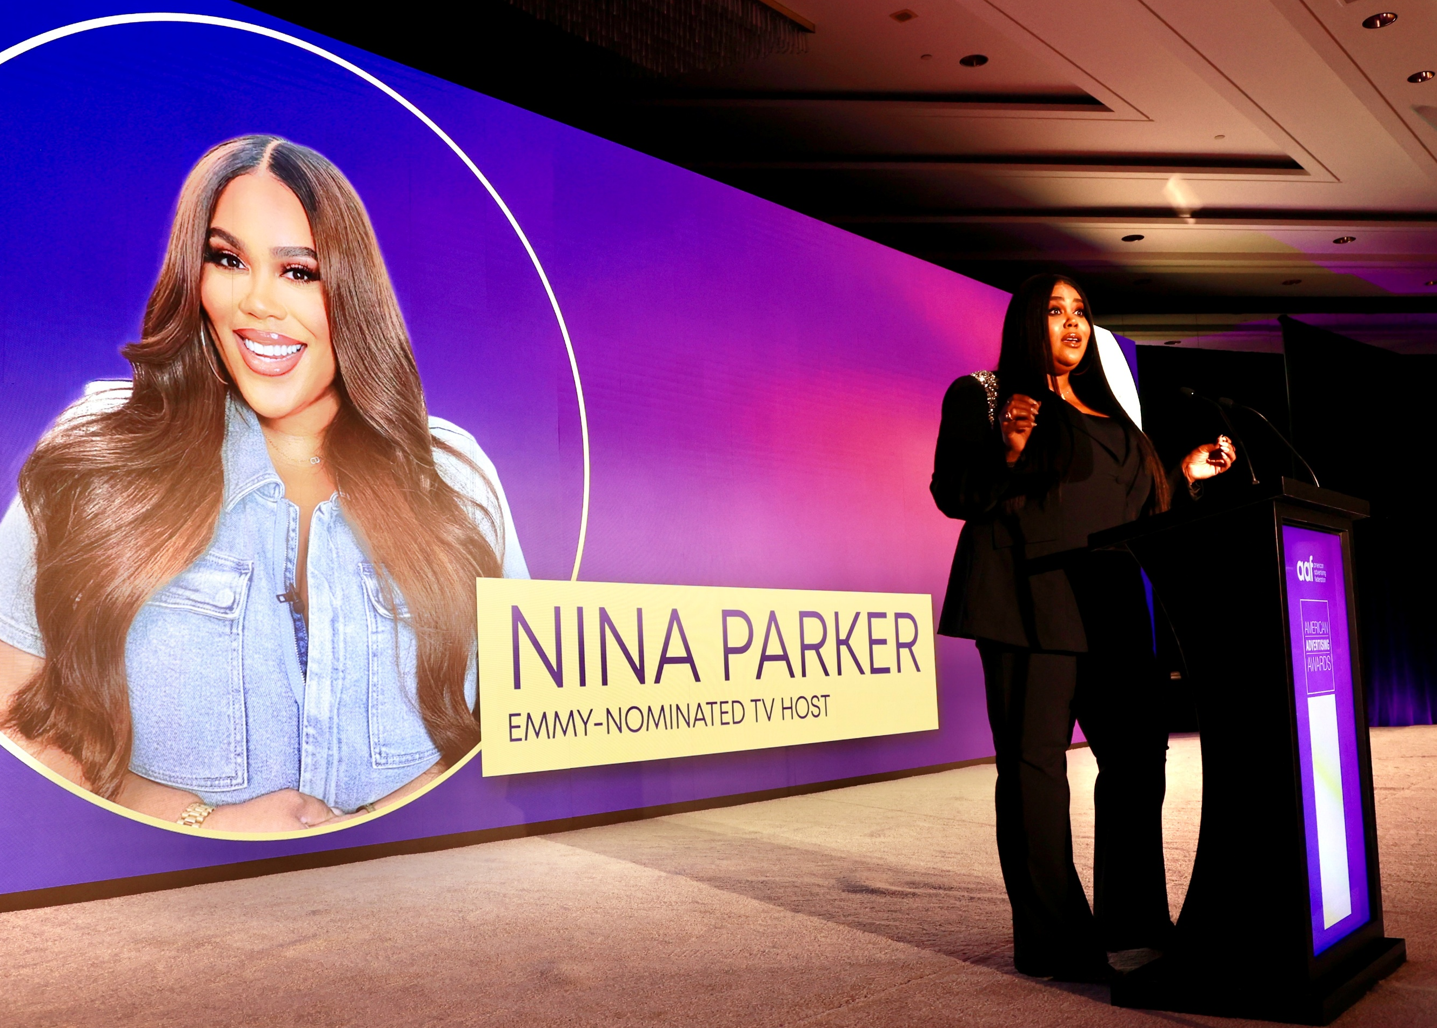
GETTING THE SPEAKER
Most chapter meeting programs center on a guest speaker addressing a topic of high interest to the membership. When determining where to source these speakers, the most reliable first step is to lean on the expertise of the Program Committee. Because committee members represent diverse sectors of the advertising industry, they can leverage their specific professional networks to find high-caliber talent.
For instance, members in the broadcast sector can tap into radio or television bureaus, agency representatives can recruit experts from major firms, and those in the printing or design fields can provide specialists in the graphic arts.

Slide 12
GETTING THE SPEAKER
Beyond the two most accessible sources (your committee and chapter members), other avenues are limited only by your imagination. Consider the following as leads to speakers:
From your local chamber of commerce or Better Business Bureau
Through careful and continuous study of programs of regional and national conventions and local trade meetings
By attendance at AAF regional and national meetings (If possible, extend invitations on the spot)
From reports on programs that appear in business and trade media
Through newsletters from other national organizations
Through other AAF chapter newsletters (sign-up for their mailing lists)
Through local newspapers, local media websites, radio and TV stations
From visitors and convention bureaus
From nearby colleges and universities
From AAF’s National Speakers Directory (Online at aaf.org/speakers)
Learn more about the various Chapter Leadership Resources
from the AAF

Slide 13

USING SPECIAL PROGRAMS
Bringing in outstanding speakers from out of town will always be a very attractive and desirable option, even though it can also be an expensive way to ensure good programming. Even when you do not pay an honorarium, the airfare and expenses alone are often high, and for many chapters, unaffordable on a regular basis. Consider contacting an ad chapter nearby and suggest they use the same speaker the following day and share the expenses. Consider the following special event programs:
AAF Speakers Directory: AAF National publishes the National Speakers Directory, online at aaf.org/speakers. This is an index of speakers interested in appearing before advertising chapters and includes topics discussed and costs involved, if any.

Slide 14
SPECIAL PROGRAMMING
Consider the following special event programs:
A program to promote the American Advertising Awards. Promote last year’s national winners which reside in your market as a means of generating more entries in your local competition. (It’s best to do this just after your call for entries goes out.)
A program to highlight legislation—Invite a member of your state legislature, your congressman or your senator to address your chapter on matters pertaining to advertising. Allow time for a question-and-answer period.
A program on education—Many valuable educational projects may be launched under this program title. These include: Advertising Career Day (in both high school and/or college), one-day seminars and workshops on professional subjects.
AAF Silver Medal Award presentation—Conducted as an annual event, the Silver Medal Award is a means of bringing favorable publicity and prestige to the chapter. It honors an individual who has made outstanding contributions to advertising and his/her community.
A program to update members on the AAF—Early in the year schedule a meeting that explains the AAF and an overview of the advertising industry.
Special Programming, continued >>>

Slide 15
SPECIAL PROGRAMMING
A program to spotlight the NSAC—Make your chapter aware of the skills of student teams in the National Student Advertising Competition. A copy of the winning team's presentation is available through the AAF.
A local economic forecast program—Schedule a panel discussion on the economic forecast for your local area.
For panel members, you might invite the manager of your chamber of commerce, the business editor of your local newspaper, a vice president of a large area bank, or others who are knowledgeable about local economic conditions. This program should be of interest to all members of your chapter.
Joint meetings—Several groups in the city have joint meetings occasionally. This offers an opportunity for a “big name” speaker who may only come for large groups.
Chapter members in the spotlight—A panel of articulate and well-spoken chapter members discusses a timely and relevant subject.

Slide 16
ETTIQUITE FOR WORKING WITH SPEAKERS

Slide 17
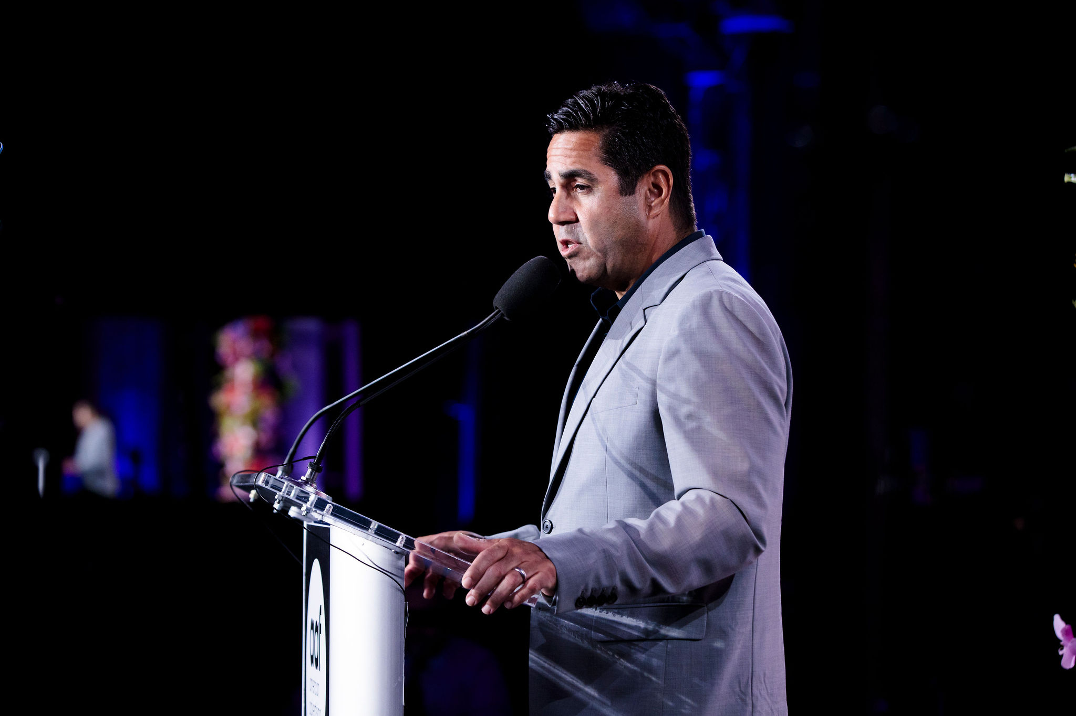
CORRESPONDING WITH SPEAKERS
Guest speakers are the single most important ingredient in your chapter’s recipe for successful programming. Speakers deserve very special consideration and treatment. Common courtesy, gratitude and respect should be your guides in dealing with guest speakers. You want every speaker to feel good about your chapter when they leave your meeting. It is not only good public relations but may even help your efforts to get other good speakers in the future.
Much of your contact with speakers will be by email. At least three letters or emails are involved: the invitation, the acknowledgement of acceptance, and the thank-you letter. When possible, it is good public relations to write a letter or e-mail to the speaker’s supervisor or the president of his/her company.

Slide 18
THE INVITATION
The invitation to the speaker:
Write the speaker at least two months in advance of the meeting.
Provide a profile of your chapter: size, history, officers, membership, programs, other speakers who have addressed the chapter, etc.
Give the date, place, theme, composition of the audience and any other information pertinent to the meeting.
Define the type of presentation desired and specify the amount of time allotted. Tell the speaker whether a question-and-answer session will or will not be expected.

Slide 19
ACCEPTANCE
Acknowledge the Acceptance Promptly:
When the speaker accepts, acknowledge the acceptance promptly.
Provide further information about the meeting.
Ask for the following:
            A photograph for publicity.
            Biographical material for publicity and introduction.
            Title of the speech.
            Specific requirements for visual aid materials: projection screen, easel, DVD, etc.
            The names of any friends or business associates the speaker would like to have attend the meeting.
Acceptance, continued >>>

Slide 20
ACCEPTANCE
Offer to:
Arrange hotel accommodations—be sure it is clear who will pick up the costs.
Meet the speaker upon arrival in your city.
Take the speaker from the hotel to the meeting.
Offer to entertain the speaker if there is any spare time before or after the speaking engagement.
In the event you are unable to meet the speaker, have a note waiting at the hotel with a welcome to the city and confirming who will meet the speaker.

Slide 21
THINGS TO REMEMBER
Inform the speaker immediately if there is any change in the scheduled meeting time and place.
A cordial reminder e-mail or phone call before the meeting date is advisable.
If possible, when you thank the speaker, present some small memento of your organization, preferably something that signifies the background of your city or something that is distinctively yours.
See that all guests are notified in advance and told when they are to meet to avoid confusion at the program itself.
Include a write-up on your chapter’s website after the presentation along with some images that can be easily shared on social platforms as a means of follow-up publicity for the event.
Write a thank-you letter for the speaker within 48 hours of the meeting or shortly thereafter. The chapter’s appreciation should be expressed in warm sincere terms. Comments complimenting the speaker on specific points in the speech are always appropriate.
When possible, the thoughtful program chairman will write a second thank-you letter to the speaker’s department head or president of the company. This is tangible proof that the speaker is a good-will ambassador for his/her company while away from the job.

Slide 22
MANAGING
THE PROGRAM

Slide 23

THE PROGRAM ANNOUNCEMENT
Make sure to communicate the program information to the membership in a timely manner. E-mail and social platforms are the go-to methods for getting information out quickly. Make sure you create event pages in the appropriate channels and communicate updates about the event often. In the week leading up to the event, you may want to place some personal texts or calls to ensure that key people will be in attendance.

Slide 24
THE PRESIDING OFFICER
The chapter president usually opens the program. The president briefly makes any necessary announcements, introduces any special guests, and then turns the program over to the program chairman. This chairman presents the various features of the day’s program and speaker.
Checklist for the Presiding Officer:
Begin and close on time.
Prepare a schedule or agenda of the program with definite time allowances for the introduction of members, announcements, entertainment features (if any), the introduction of the speaker, and the speech itself. Give copies of the schedule or agenda to those in charge of the program.
Make only necessary announcements and keep them brief and to the point.
Do not bore guests and the speaker with long committee reports or discussions of chapter business that properly belong in a closed business session.
Presiding Officer, continued >>>

Slide 25
THE PRESIDING OFFICER
Keep all entertainment features to the allotted time.
Make the speaker's introduction brief. Be correct in the pronunciation of the name, position, and business affiliation of the speaker.
Use humor with care.
Have a definite understanding with the speaker regarding the time allotted for the talk.
After the speech, thank the speaker gracefully, but again be brief.

Slide 26
SPECIAL REMINDERS
Make sure the speaker is aware of the reimbursement process. If they must submit an expense report with receipts, make the process as easy as possible for them. Submit the reimbursement as quickly as possible (no more than 2 weeks after the presentation).
Prepare a digital piece giving full details regarding the speaker and subject.
Email copies and post on the appropriate social channels, if possible, a week in advance of the program.
Check the initials and spelling of the speaker’s name and business affiliation carefully in all advance publicity and in the program announcement.
See that the presiding officer has the speaker’s correct initials and title and knows how to pronounce the name.
Be sure the speaker is introduced to chapter officers and distinguished guests.
A cue card with information about guests in the order in which they are seated at the head table will enable the president, or whoever is responsible, to introduce them quickly and accurately.
Keep a record of each program with the speaker’s name and subject, the attendance record, type of announcement, report of weather conditions and any other factors that might have some bearing on attendance and interest. This information will be invaluable to future program committees.

Slide 27
PROGRAMMING IDEAS
Music Is Advertising, a presentation by an outstanding “jingle” creator.
A time management program.
Publisher of a very successful national magazine.
Major advertising agency presentation, introducing a new product.
How to Start an Advertising Agency.
Former presidential press secretary.
Panel on TV programming.
Advertising and the Law.
A Look at Rating Services.
Outtakes from TV spots.
National American Advertising Awards reel.
Retail advertising workshop.
Media workshops: newspapers, radio, internet, TV, magazines, etc.
Political Advertising—An Examination.
Sports programs, featuring outstanding sports personalities.
National Student Advertising Competition reel of winning presentation.

Slide 28
MANAGING A CANCELLATION
No one can prevent “acts of God,” and indeed everything from illness and client demands to snowstorms and floods can prevent your speaker from showing up for your program. You can plan for such emergencies and set up a reserve of programs in case a speaker cancels.
The following are a few things you can do in case of cancellation:
First, check with your scheduled speaker; perhaps a substitute can be provided.
Call upon an interested personality within your own community.
Consider rescheduling one of your other speakers.
Look to your chapter members for strong advertising-oriented programs that can be substituted at a moment’s notice.
Panels of members on creativity (print, digital, or broadcast) can be very effective.
Retail advertisers from nearby communities can often be asked to fill an emergency program discussing their approach to advertising.
Faculty of local colleges often have prepared presentations or can present their students’ work from classroom situations.
The key is asking in advance that such programs be available in case of emergency.

Slide 29
CHECKLIST FOR THE PROGRAM CHAIR

Slide 30

CHECKLIST FOR THE PROGRAM CHAIR
When planning your next program, ask these questions:
Who Should Serve?
What Do You Need to Know?
When Should You Begin?
How Does the Committee Function?
Why is This Committee so Important?

Slide 31
CHECKLIST FOR THE
PROGRAM CHAIR
Who Should Serve?
Chapter representatives of as many facets of advertising as possible to ensure a well-rounded approach to chapter programming.
A balance of innovative thinkers and conservative members so programs will not be too avant-garde or too stodgy.
Members who understand the membership’s attitude toward programs but will retain the objective of programming oriented to advertising.
Checklist for the Program Chair, continued >>>

Slide 32
CHECKLIST FOR THE
PROGRAM CHAIR
What Do You Need to Know?
A schedule of chapter program dates and their proposed location(s).
What “traditional” program dates must be accommodated, i.e., American Advertising Awards gala, Silver Medal ceremony, Christmas party, past president’s day, students' day, awards ceremonies, etc., that are annually scheduled at about the same time each year.
Membership preference in programs. A survey of the membership completed prior to the beginning of the chapter year regarding program preference can be useful.
The size of the budget. Your chapter must allocate a reasonable amount to program expenses.
Availability and costs for audiovisual equipment in your community, and more specifically at the locations(s) of your programs.
Checklist for the Program Chair, continued >>>

Slide 33
CHECKLIST FOR THE
PROGRAM CHAIR
When Should You Begin?
90 days before your first scheduled program is not too soon. Speakers need plenty of lead time to commit to a date.
Schedule regular meetings of the committee. Keep the committee abreast of changes and opportunities.
Checklist for the Program Chair, continued >>>

Slide 34
CHECKLIST FOR THE
PROGRAM CHAIR
How Does the Committee Function?
Establish a tentative list of attractive speakers and program features within the framework of your survey results.
Prepare a model invitation and follow-up letter to speakers.
Develop a checklist to cover program details such as accommodations and local transportation, program notes, introductions for the president and A/V requirements.
Designate committee members to follow up on each tentative program. Each committee member should be charged to deliver a report on progress to the full committee at the next program. Committee members must stay within budget and have the responsibility for program details outlined above.
Assign one or more committee members to serve as promotion liaison to keep the communications chair informed of the programs and communicates with any local media.

Slide 35

WHY IS THIS COMMITTEE SO IMPORTANT?
Time and again, surveys of chapters have emphasized that a major reason for membership is the opportunity to attend good programs. Without good and varied programs, attendance at regular meetings declines. Your chapter membership committee loses a valuable tool to convince prospective members of the value of membership.

Slide 36
APPENDIX A
Program Planning Guide

Slide 37
A
Click to Download Guide

